Slide 1
A graph oriented database implemented in DEX for protein structural information.
²Larriba-Pey JL
¹Valdés-Jiménez A
¹Reyes JA
²Dominguez-Sal D
¹Arenas-Salinas MA
Centro de Bioinformática y Simulación Molecular, Facultad de Ingeniería, Universidad de Talca.
DAMA-UPC, Data Management Universitat Politecnica de Catalunya

Slide 2
Introduction
Proteins are essential macromolecules of great interest for the study of diseases and the development of novel drug-targets.
The analysis and understanding of the tri-dimensional (3D) structure of these proteins could help us to comprehend the molecular mechanisms involved in living organisms.
Examples of how the information stored in this graph-oriented database can be employed to make queries and find structural patterns among different proteins.

Slide 3
Yearly growth of total structures*
[*] http://www.pdb.org/pdb/static.do?p=general_information/pdb_statistics/index.html

Slide 4
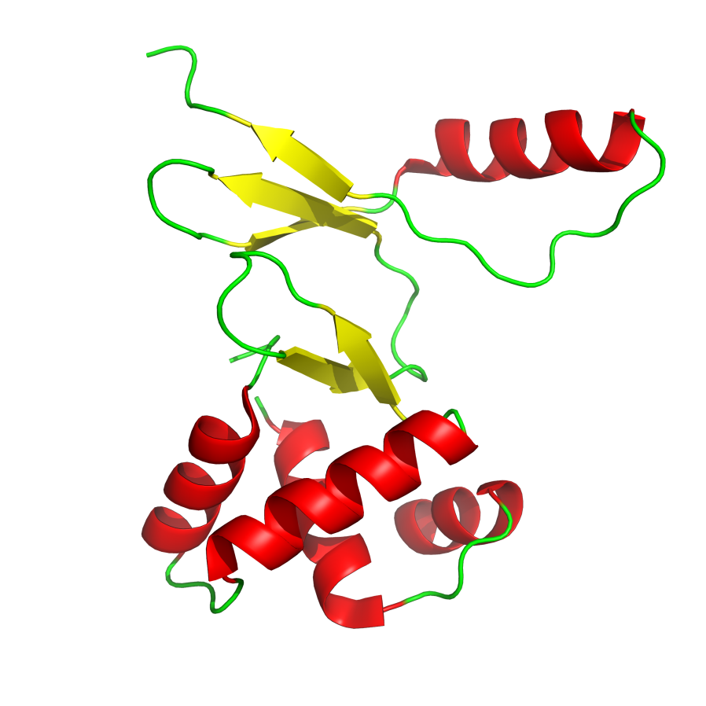
PDB file format

Slide 5
Schema implemented

Slide 6
Steps to populate the database

Slide 7
Statistics
PDBs files processed: 74,208 (73GB)
Size DEX database: 106,730MB
Nodes: 481,888,415
Edges: 480,317,207 (without distance calculation)
Total: 962,205,622
Data preparation: 4 days.
Data import: 7 days.

Slide 8
Test Queries
Show protein information.
Searching a zinc finger motif (class C2H2) given a hetatm.
Searching subseq over all sequences of all proteins (POSIX regular expression).
Searching atoms neighbors of a hetatom (by distance in angstrom).
Calculate AFAL (Aminoacid Frequency Around Ligan) of ZN.
Statistics of database.

Slide 9
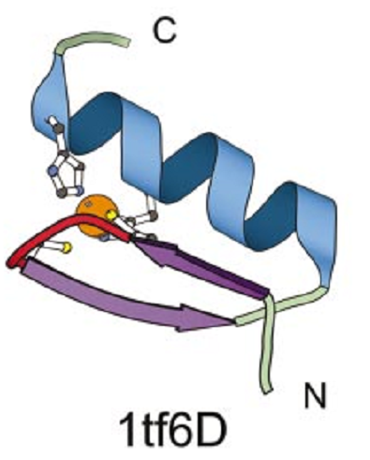
Example: Zinc Finger (C2H2 motif)
'Zinc finger' domains are nucleic acid-binding protein structures. These domains have since been found in numerous nucleic acid-binding proteins. A zinc finger domain is composed of 25 to 30 amino-acid residues. There are two cysteine or histidine residues at both extremities of the domain, which are involved in the tetrahedral coordination of a zinc atom. It has been proposed that such a domain interacts with about five nucleotides. A schematic representation of a zinc finger domain is shown below:
His (H)
Cys (C)
Sequence alignment

Slide 10
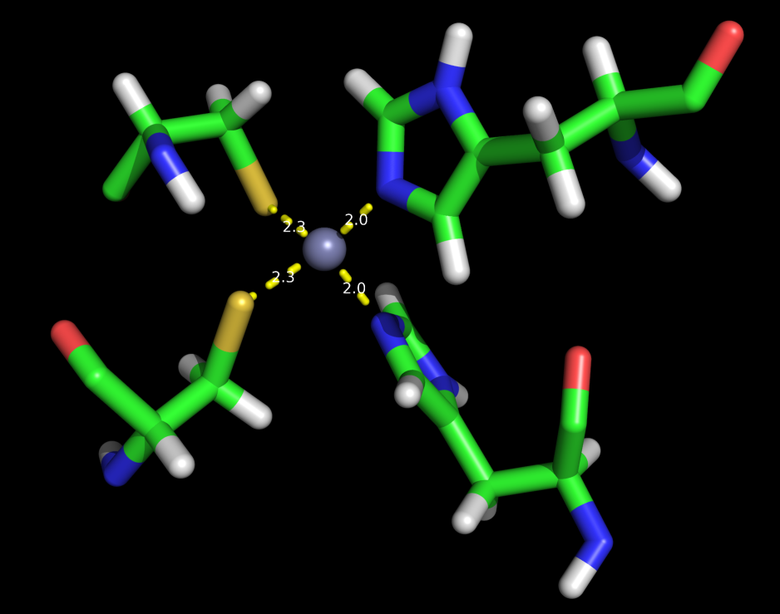
Result of search of Zinc Finger motif (C2H2)
CYS
HYS

Slide 11
Working ...
Search for structural patterns
Integration with other biological databases
Incorporation of new attributes
Benchmark.

